Slide 1


Prerequisites for Therapeutic Studies in Humans
and Phase I Trials
August 3, 2022
Rosalyn Juergens,
MD PhD

Slide 2
Disclosures
Company | Relationship(s)
Alkermes | Contracted Research
Amgen | Advisory Board, Honoraria, Contracted Research
Astellas | Contracted Research
AstraZeneca | Advisory Board, Honoraria, Contracted Research
Bayer | Advisory Board
Bold Therapeutics | Contracted Research
Bristol Myers Squibb | Advisory Board, Consultant, Honoraria, Contracted Research
EMD Serono | Advisory Board
Fusion Pharmaceuticals | Advisory Board, Contracted Research
Company | Relationship(s)
Jazz Pharmaceuticals | Advisory Board, Honoraria
Janssen Pharmaceuticals | Advisory Board; Contracted Research
Lilly | Advisory Board
Macrogenics | Contracted Research
Merck Sharp and Dohme | Advisory Board, Consultant, Honoraria, Contracted Research
Mirati | Honoraria
Novartis | Advisory Board, Contracted Research, Honoraria
Pfizer | Advisory Board, Consultant
Roche | Advisory Board; Honoraria
Sanofi | Advisory Board
Takeda | Advisory Board, Honoraria
I will be discussing treatments not yet
approved by Health Canada

Slide 3
Acknowledgements
Phil Bedard, MD FRCPC (2019 Lecturer)
Albiruni R Abdul Razak, MB BCh, BM BCh (2017 Lecturer)
Sarit Assouline, MD, MSc, FRCPC (2017 Lecturer)
Lesley Seymour, MD, FCP (SA), FRCP(C), PhD
Elizabeth Eisenhauer, MD FRCPC
Charles Rudin, MD PhD
Julie Brahmer, MD MSc

Slide 4
Objectives
Describe the pre-clinical work entailed in bringing new treatments into human trials
Review the basic statistical designs incorporated in phase 1 clinical trials
Highlight the changes in early phase drug development

Slide 5
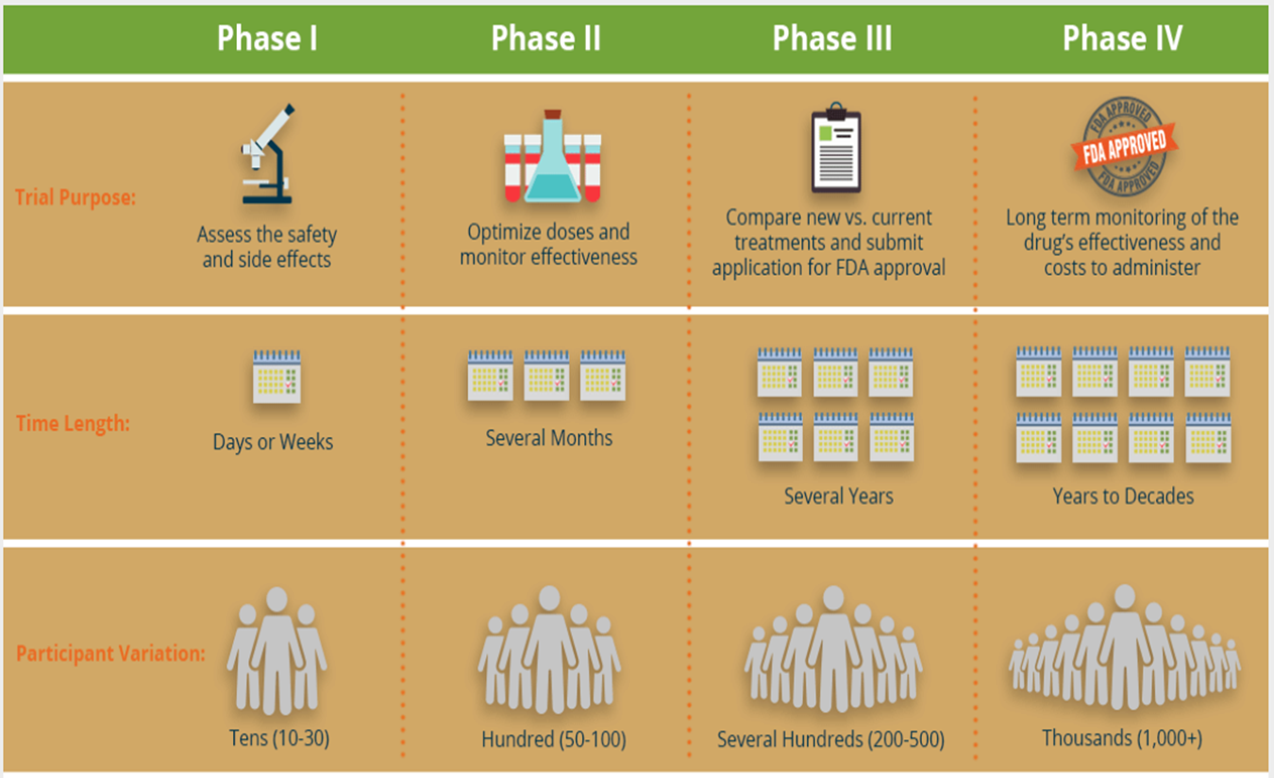
Drug Development Paradigm

Slide 6
Pre-requisites for First in Human Trials
Biological plausibility (target validation)
Expectation of benefit (preclinical activity)
Reasonable expectation of safety (preclinical toxicology)
Basis for selection of starting dose

Slide 7
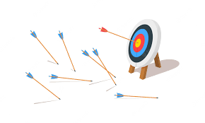
The Target
Biological Plausibility
  Knock-in/Knock-out experiments
Role in disease pathogenesis
  ie. Bcr-Abl, c-KIT, BRAF, etc
Expression in clinical specimens
  Tumor types, prevalence, tissue specificity
  All comers vs enriched design
  Resistant vs naïve population
Prognostic/Predictive
Prior attempts to drug target

Slide 8
Required knowledge for regulatory submission
Production
  Good Manufacturing Practice (GMP)
  Sufficient quantities & practical dosage forms
Chemistry
  Small molecule, antibody, anti-sense, peptide, etc
Absorption (PO/IV)
Distribution (tissue concentration, reservoirs, BBB)
Metabolism & Excretion
  CYP enzymes, metabolites, route of excretion

Slide 9
Treatment Properties
Pharmacokinetic (PK) Profile
  Maximum concentration (Cmax)
  Exposure (AUC),
  Half-life (T½),
  Distribution
Accumulation & multiple dose effects
PK-toxicity association
PK-efficacy association
Impact on Trial Design
Route & schedule of administration
Eligibility criteria (renal & hepatic function)
Concomitant meds
PK/PD sampling time points

Slide 10
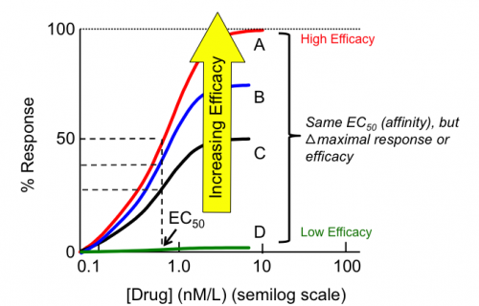
Pre-Clinical Efficacy
No specifically mandated studies
Up to the company and investigators
Not predictive of success
But high negative predictive value
What to look for:
Multiple xenograft models (>2)
Models with established tumors +/- mets before treatment
(if applicable)
Regression rather than growth delay
IV or PO administration
Dose response effects (and plasma drug levels)

Slide 11

Pre-clinical Toxicology
Typically a rodent (mouse or rat) and non-rodent
(dog or non-human primate) species
Monoclonal antibodies require cross-reactive species
(ie. primate)
Few animal organ specific toxicities predict for human toxicities
  Myelosuppression and gastrointestinal toxicity more predictable
  Hepatic and renal toxicities –large false positive

Slide 12
Required Toxicology
Type of dosing | Requirements
Single Dose | 2 species: rodent & non-rodent Clinical formulation Several doses studied Determine toxicity and organ effects NOAEL; LD10 PK for relationship to exposure and effects Species specific if required Target Toxic effects
Chronic Toxicity | 2 species: rodent and non-rodent Duration of treatment Rodents: 6 months Non-rodents: 9-12 months Determine chronic or late effects of treatment including severity and reversibility
Genotoxicity | In vitro tests for mutations and chromosomal damage from the agent
Local toxicity | Local tolerance using routes relevant to method of administration

Slide 13
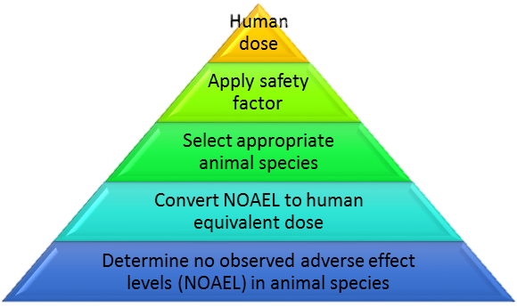
Starting Dose Considerations
LD10 (Lethal dose 10)
  Dose that is lethal in 10% of animals
NOAEL (No observed adverse event level)
  The highest tested dose that has no
  harmful or adverse event in the animals
TDL (Toxic dose low)
  The lowest tested dose that caused
  any toxic effect in the animals
Minimum anticipated biological effect level (MABEL)
  Often used as a starting dose for antibodies

Slide 15
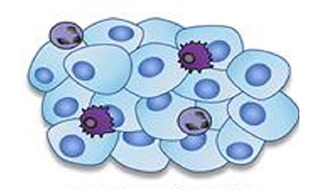
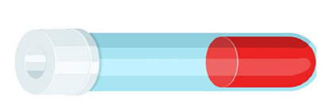
Biomarker Assays
Impact on Trial Design
Will it provide useful information?
(proof of mechanism or proof of concept)
  Increases complexity & cost
  Limits patient numbers
  Requires “clinical grade” assay
Patient selection
Serial tumor biopsies vs “surrogate” tissue
All comers vs expansion only

Slide 16
Objectives of Phase I Clinical Trials
Primary:
Identify dose-limiting toxicities (DLTs) and
the recommended phase II dose (RPTD)
Secondary:
Describe the toxicity profile of the new therapy in the schedule
under evaluation
Assess pharmacokinetics (PK)
Assess pharmacodynamics effects (PD) in tumor and/or
surrogate tissues
Document any preliminary evidence of objective antitumor activity

Slide 17

Patient Population
“Conventional” generic eligibility criteria-examples:
Advanced solid tumors unresponsive to standard therapies or for which there is no known effective treatment
Performance status (e.g. ECOG 0 or 1)
Adequate organ functions (e.g. ANC, platelets, Creatinine, AST/ALT, bilirubin)
Specification about lines or types of prior therapy allowed
Specification about time interval between prior therapy and initiation of study treatment
No serious uncontrolled medical disorder or active infection

Slide 18

Patient Population
  “Agent-specific” eligibility criteria-examples:
  Specific organ exclusions:
  Cardiac function (e.g. QTc≥450-470 ms, LVEF ≤ 50%, etc), acute MI/CVA if preclinical cardiac risk
  Recent hemorrhage or ongoing anticoagulation for agents with bleeding risk (ie. antiangiogenic)
  Diabetes or fasting plasma hyperglycemia ≥ 7.0 mmol/L for agents with risk of hyperglycemia(ie. PI3K/AKT)
Prohibited medications if significant risk of interaction with study drug
Prior exposure to drug in same class

Slide 19
Dose Limiting Toxicity
Toxicity that is considered unacceptable (due to severity and/or irreversibility) and limits further dose escalation
Specified using standardized grading criteria (ie. CTCAE)
DLT is defined in advance prior to beginning the trial and is protocol-specific
Typically defined based on toxicity seen in the first cycle

Slide 20
Common Terminology Criteria for Adverse Events (CTCAE)
Grade 1 = MILD
Grade 2 = MODERATE
Grade 3 = SEVERE
Grade 4 = LIFE-THREATENING
Grade 5 = FATAL
Multiple versions – Version 6.0 launching Fall 2022
Lots of apps available for download for ease of searching for refined terms or grades

Slide 21
Dose Limiting Toxicity (DLT) Criteria – Intermittent Dosing
Generally can tolerate higher degrees of toxicity because the interval between treatments allows for rest and recovery
Examples:
  Grade ≥ 3 non-hematologic toxicity despite supportive measures
  ANC < 0.5 x 10⁹/L for > 5 or 7 days
  Febrile neutropenia (ANC < 1 x 10⁹/L, fever > 38.5ºC)
  Platelets < 25 x 10⁹/L or thrombocytopenic bleeding
  Inability to re-treat patient within 2 weeks of scheduled treatment

Slide 22
DLT Criteria – Continuous Dosing
Threshold for DLTs is lower
Some Grade 2 toxicities may be unacceptable and intolerable due to their persistence and lack of time period for recovery
Examples:
  Grade 2 intolerable or worse non-hematologic toxicity despite supportive measures
  Recurrent Grade 2 intolerable toxicity after interruption
  Grade 3 or worse hematologic toxicity
  Inability to complete a pre-specified percentage of treatment during the cycle due to toxicity
  (e.g. missing 20-25% of doses)

Slide 23

Key Principles of Phase I Trial Designs
Start with a safe starting dose
Minimize # of pts treated at sub-toxic doses
Escalate dose rapidly in the absence of toxicity
Escalate dose slowly in the presence of toxicity
Expand patient cohort at maximum tolerated dose

Slide 24
Recommended Phase 2 Dose (RP2D)
Recommended phase II dose (RP2D, RPTD or RD):
  Dose associated with DLT in a pre-specified proportion of patients (e.g. < 33%) –dose that will be used in subsequent phase II trials

Slide 25
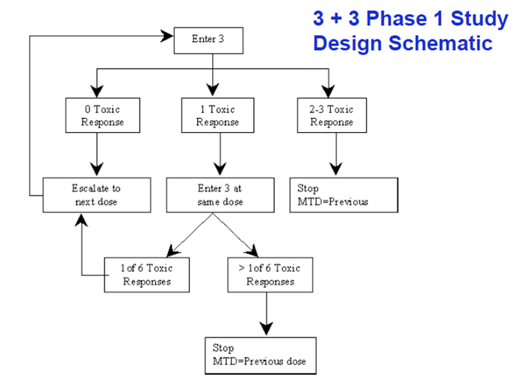
Early phase drug development: 3+3 design
Paoletti, X, et al, Annals of Oncology 26: 1808–1812, 2015
Notes:
Adjust font size and placement as needed to fit your content.

Slide 26
Classical Dose Escalation Scheme
Modified Fibonacci sequence in which ever higher escalation steps have ever decreasing relative increments

Slide 27
Basics of the 3+3 Design
Main Objective
Identify the maximum tolerated dose
Assumptions
Increased dose = increased efficacy
Increased dose = increased toxicity
Most significant toxicities occur within the set DLT period (21-28 days)
Limitations of the 3+3 design
Many patients are likely to be treated at low doses
Not all toxicity data of all patients are used to determine the MTD
Late toxicities are not considered
Low probability of selecting true MTD
High variability in MTD estimates
(too few patients treated close to the MTD)

Slide 28
Accelerated Titration Design
First proposed by Simon et al
(J Natl Cancer Inst 1997)
Several variations exist:
  Usual is doubling dose in single-patient cohorts till grade 2 toxicity then revert to standard 3+3 design using a 40% dose escalation
  Intra-patient dose escalation allowed in some variations
  More rapid initial escalation

Slide 29
Continuous Reassessment Model (CRM)
Each patient is allocated to the dose most likely to be the MTD, according to the current state of the model.
The model is “immediately” updated by incorporating first course toxicity data from each successive patient. The MTD is calculated from the final state of the model.
Fewer patients treated at suboptimal dose.
More precise estimate of the MTD.
DLT determined based on all available toxicity data.
Ongoing computational efforts and communication with biostatistician.

Slide 30
Modified Toxicity Probability Interval (mTPI) Design: An Adaptive Design
Ji Y and Wang S-Y. J ClinOncol31: 1785-1791, 2013

Slide 31
Limitations of Phase I Trials
Chronic or cumulative toxicities usually cannot be assessed
Uncommon toxicities will be missed
Low likelihood of therapeutic benefit
Overall response rate = 5-10%
Majority of responses occur at 75-125% of recommended phase II dose
Low risk of toxic death (<0.1%)

Slide 32

Accommodating for late toxicity
Prolong the DLT period beyond the typical 28 days
  Done in the first in human trials of PD-1/PD-L1 CPIs
Use the Time To Event Continual Reassessment Model (TITE-CRM)
  Model-based and requires practitioners to pre-specify the toxicity probability at each dose
  Utilizes information from partially observed subjects throughout the trial
  No staggering enrollment
  In the absence of a DLT, weights each entered patient by the proportion of the full observation period that he/she has been observed.
Bayesian Optimal Interval (BOIN)
  Allows endpoints such as delayed response, co-primary efficacy or efficacy / toxicity
  Shorter trial duration due to real-time go/no-go decision making when some patients’ outcomes are pending
  Maximizes statistical power with a well-controlled type I error rate by incorporating all available trial information in decision making
  Transparent with decision making rules pre-tabulated
Cheung, YK and Chappell. R, Biometrics 2000; 56 , 1177-1182;
Liu, S et al. Journal of the American Stat Assn 2018; 113:523, 1016-1027
Notes:
Adjust font size and placement as needed to fit your content.

Slide 33
When More ≠ Better
Development of ipilimumab
  Phase I trials at doses ranging from 3 mg/kg to 20 mg/kg, without an MTD being identified in any of the trials.
  A subsequent Phase II trial compared three dose levels of ipilimumab in patients with metastatic melanoma (0.3, 3, and 10 mg/kg)
  Phase III and FDA approved single agent dose = 3 mg/kg
Ideal to incorporate pharmacodynamic endpoints including use of blood based biomarkers like circulating tumour DNA to establish the threshold for garnering a response or triggering on target effects
Wages et al. Journal for ImmunoTherapy of Cancer (2018) 6:81
Notes:
Adjust font size and placement as needed to fit your content.

Slide 34
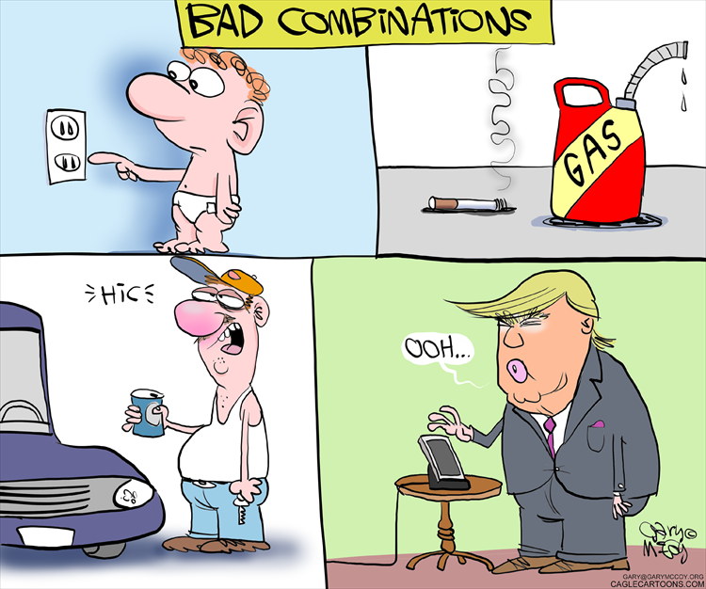
Challenges of multiple combinations
https://www.cagle.com/gary-mccoy/2017/05/bad-combinations
Notes:
Adjust font size and placement as needed to fit your content.

Slide 35
Methodology for the Development of Innovative Cancer Therapies Task Force Statements
What are the optimal endpoints / early phase trial designs
  Evaluation of pharmacodynamic biomarkers incorporated into trial objectives and go/no-go decisions
  Master Protocols (Basket, umbrella, and platform designs) and enhance efficiency
  Primary outcome: response based rather than time to event
What data is required to justify a combination?
  Robust hypothesis, with evidence of efficacy and pharmacodynamic effects in pre-clinical studies
  Evidence of single agent activity, or compelling pre-clinical data
Smoragiewicz, M et al. Annals of Oncology 2018; 29: 2175–2182

Slide 36
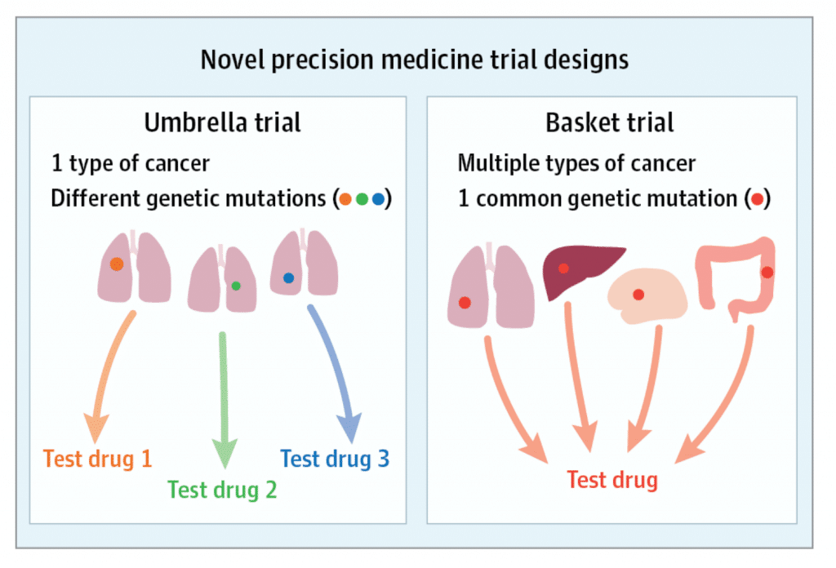
Novel types of treatment trials
Basket trials (also called Bucket trials)
  Multiple different types (sub-types) of cancer
  Same mutation or biomarker
  Also useful in rare subtypes of cancer
  All receive the same investigational agent
Umbrella trials
  Single type of cancer
  Multiple arms with assignment determined by a biomarker
  Multiple investigational agents
  May be controlled within each arm (randomized) or uncontrolled
Biomarkers either tissue or plasma can be useful to for these trials.
For basket trials, broad screening done outside of the trial is most useful to “pre-screen” for trial participation.
For umbrella trials, the molecular testing is often an integral biomarker (ie: embedded in the trial design).
West, J. JAMA Oncol. 2017;3(3):42

Slide 37
Evolution of Cancer Drug Development
Postel-Vinay, Annals of Oncology, 2016

Slide 38
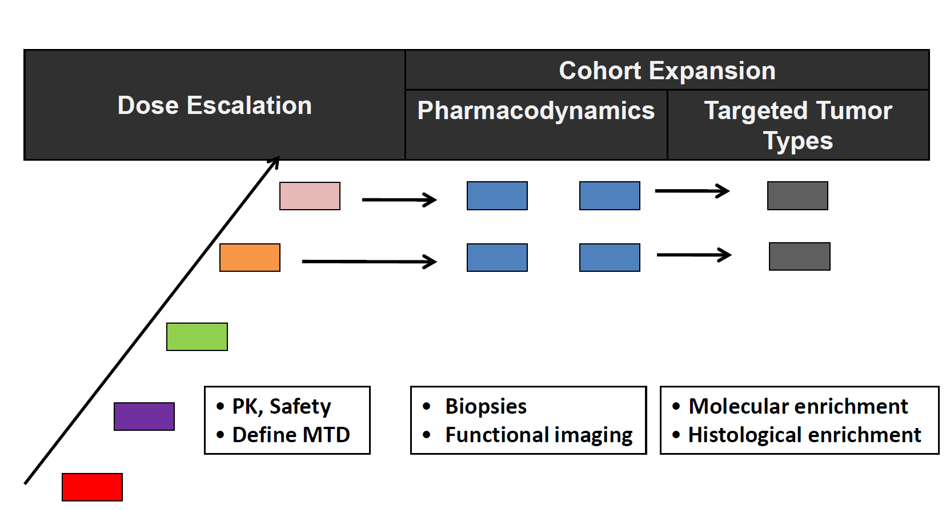
“Seamless” Phase I/II Trial Schemas

Slide 39
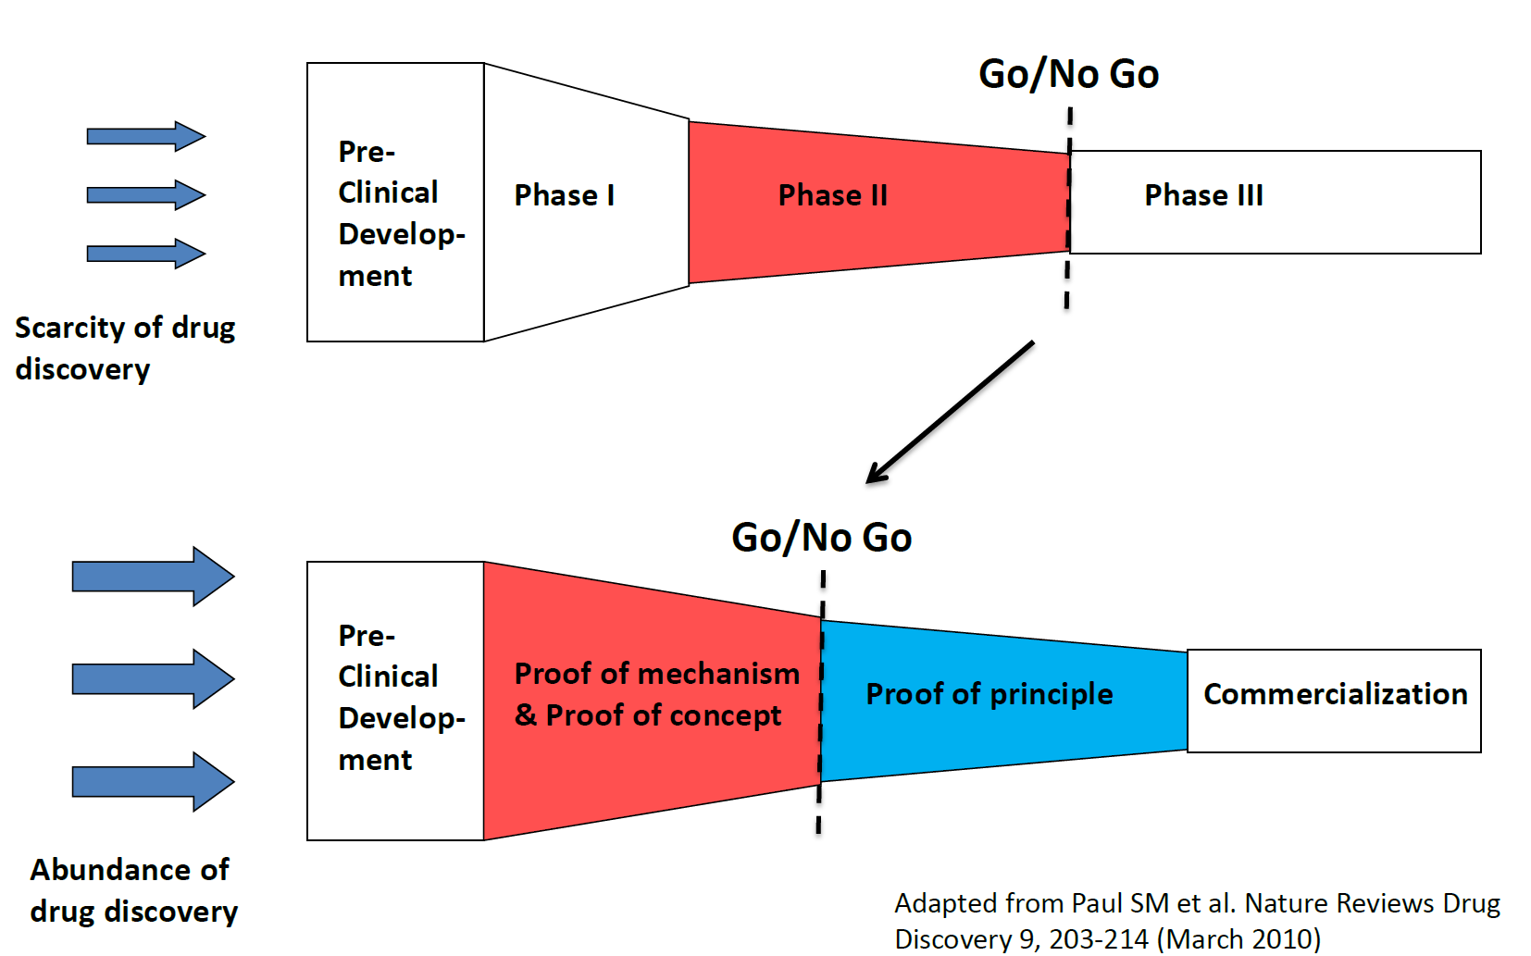
Moving the Go/No-Go Decision Point

Slide 40


